Slide 1
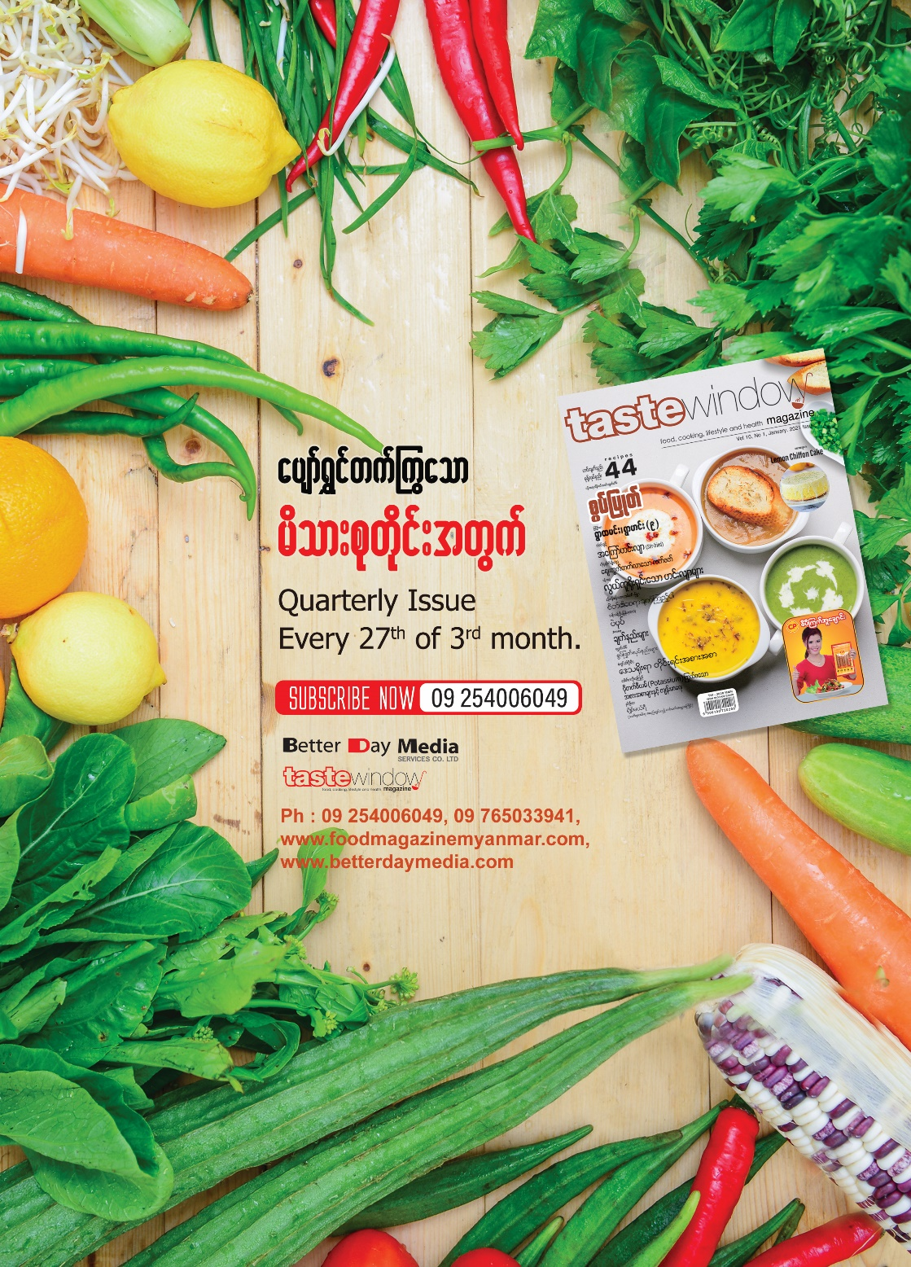
About Taste Window Magazine
Quarterly Issue :
Every 27th of 3rd month.
Circulation :
3000 pcs
Retail Price :
6,500MMK
Print Distribution
Our publications are nation wide distributed available on all major book stores - over 100 book stores, all City Mart outlets.
Digital Version available in all platform on local/international
e-book stores.
About
The Taste Window Magazine is the first monthly magazine of its kind in Myanmar language and one of the best selling magazines in Myanmar. The magazine has begun to be published since January 2012. Its aims at an active, happy and prosperous family and everyone who is interested in foods and drinks. Taste Window Magazine is packed full of recipes of Taste Window Magazine’s stars. And Taste Window Magazine includes ”Celebrites in the Kitchen”, ”Kids in the Kitchen”, ”Food and Health”, “Food and Travel”, “Eating Out (Restaurant Review)”, “Chef Feature” and a lot more. It is available wherever books are sold. Also available Digital Vision.
1

Slide 2
Taste Window Magazine Print Rate
Particulars | Rate
Back Cover | 1,500,000
Inner Back Cover | 800,000
Front Cover Box | 2,000,000
Inner Front Cover | 1,000,000
First Page | 1,000,000
Inner Page (Full) | 300,000
Tag Line 3 with Full Page | 800,000
* 15 % Discount on one year booking
Updated on 15th September 2023
2

Slide 3
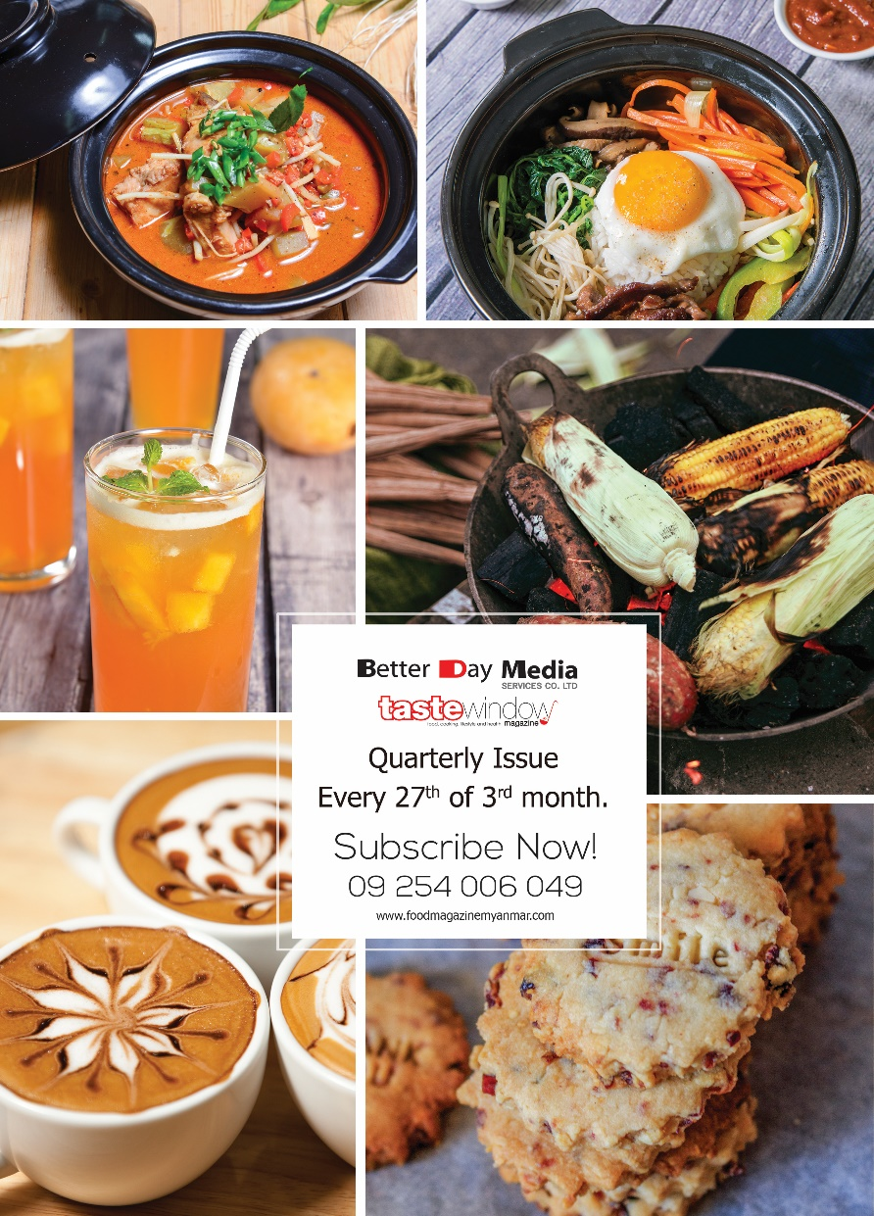
^{Artwork Specifications}
^{Artwork Specification}
^{Full Page - 8.625 x 11.625 in}
^{Half Page - 8.625 x 5.875 in}
^{- Tag Line - 8.625 x 2.125 in}
^{Full Page}
^{Half Page}
^{Full Page}
^{Tag Line}
^{Size}
^{Requirement size is mentioned}
^{Format/Resolution}
PDF(min.300dpi).(Ai,INDD,PSD) with all links.
^{Bleeding}
0.125 in/3mm bleed on all sides.
^{Colour}
^{For print artwork : CMYK mode}
For digital artwork RGB or CMYK
^{File Name}
Eg, Company Name-Product Name-Size.pdf
Company Name-Product Name-Size.jpeg
^{Submission for CD rom}
Please mention following details
^{a-Company name}
^{b-Media name/Place}
^{For email submission}
marketing@foodmagazinemyanmar.com
^{sales@betterdaymedia.com}
^{Note}
* Any important information logo, Phone number, address, etc. have to be designed within 1cm off the borderlines.
We are not responsible for any art work do not meet mentioned requirements.
^{Tag Line}
3

Slide 4
Half Potato Cooking Video Rate
Particulars | Normal Price Per Episode | Price Per Episode
1Episode | 650,000 | 1,500,000
2Episode | 1,000,000 | 2,600,000
3Episode | 1,250,000 | 3,600,000
4Episode | 1,500,000 | 4,000,000
Half Potato Cooking Video Services
*Pre Roll (5Sec)
*Crawler (5Sec) *Product Talk
*Logo
*Product Used (exclusive)
*Product Seen (exclusive)
Episodes Duration : | 3-5 Minutes
Host : | A Talent Chef
Broadcasting Media : | Better Day Media/
Media Platform : | Online
Updated on 15th September 2023
4

Slide 5
Reasons to advertise with us,
1. Most popular magazine in its kind.
2. It is also available digital version.
3. Active, happy and well off audience.
^{4. Customized budgets.}
5. Effective distribution channels
^{reach out and engage with over}
^{3 millions audience.}
5

Slide 6
NOTE
Rates exclude 5% commercial tax. The payment amount in full has to be paid 7 days before the advertisement described. All payments are non-refundable. Taste Window magazine will deliver 5 copies of magazine in which the advertisement is described. Advertiser is responsible for all necessary licenses and copy right to use the content mentioned in the advertisement.
Please contact our sales team : 09777002771, 09254006049
marketing@foodmagazinemyanmar.com, sales@betterdaymedia.com.
6

